Slide 1
Chapter 12
SUPERVISED LEARNING
Rule Algorithms and their Hybrids
Part 2
Cios / Pedrycz / Swiniarski / Kurgan

Slide 2
Rule Algorithms
Rule algorithms are also referred to as rule learners.
Rule induction (generation) is distinct from generation of decision trees.
It is more complex to generate rules directly from data than to write a set of rules from a decision tree.
© 2007 Cios / Pedrycz / Swiniarski / Kurgan

Slide 3
Rule Algorithms
Algorithm | Complexity
ID3 | O(n)
C4.5 rules | O(n³)
C5.0 | O(n log n)
DataSqeezer | O(n log n)
CN2 | O(n²)
CLIP4 | O(n²)
© 2007 Cios / Pedrycz / Swiniarski / Kurgan

Slide 4
DataSqueezer Algorithm
Let us denote training dataset by D,
consisting of s examples and k attributes.
The subsets of positive examples, DP, and negative
examples, DN, satisfy these properties:
DP ∪ DN = D, DP ∩ DN = ∅, DN ≠ ∅, and DP ≠ ∅
© 2007 Cios / Pedrycz / Swiniarski / Kurgan

Slide 5
DataSqueezer Algorithm
The matrix of positive examples is denoted as POS and their number as NPOS;
similarly NEG denotes matrix of negative examples and their number is NNEG.
The POS and NEG matrices are formed by using all positive and negative examples, where examples are represented by rows, and features/attributes by columns.
© 2007 Cios / Pedrycz / Swiniarski / Kurgan

Slide 6
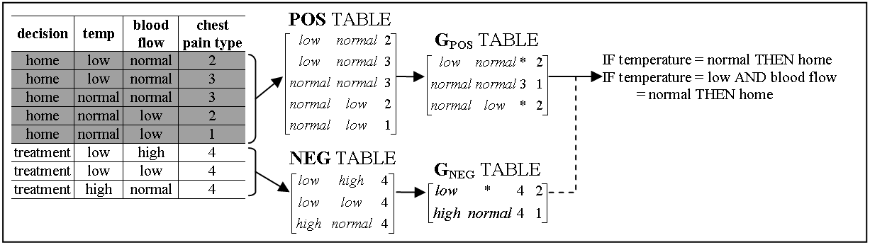
DataSqueezer Algorithm
© 2007 Cios / Pedrycz / Swiniarski / Kurgan

Slide 7
DataSqueezer Algorithm
Given: POS, NEG, k (number of attributes), s (number of examples)
Step1.
1.1 G_{POS} = DataReduction(POS, k);
1.2 G_{NEG} = DataReduction(NEG k);
Step2.
2.1 Initialize RULES = []; i=1; // where rules_{i} denotes i^{th} rule stored in RULES
2.2 create LIST = list of all columns in G_{POS}
2.3 within every G_{POS} column that is on LIST, for every non missing value a from selected column j compute sum, s_{aj}, of values of gpos_{i}[k+1] for every row i, in which a appears and multiply s_{aj}, by the number of values the attribute j has
2.4 select maximal s_{aj}, remove j from LIST, add “j = a” selector to rules_{i}
2.5.1 if rules_{i} does not describe any rows in G_{NEG}
2.5.2 then remove all rows described by rules_{i} from G_{POS}, i=i+1;
2.5.3 if G_{POS} is not empty go to 2.2, else terminate
2.5.4 else go to 2.3
Output: RULES describing POS
DataReduction (D, k) // data reduction procedure for D=POS or D=NEG
DR.1 Initialize G = []; i=1; tmp = d₁; g₁ = d₁; g₁[k+1]=1;
DR.2.1 for j=1 to N_{D} // for positive/negative data; N_{D} is N_{POS} or N_{NEG}
DR.2.2 for kk = 1 to k // for all attributes
DR.2.3 if (d_{j}[kk] ≠ tmp[kk] or d_{j}[kk] = ‘∗’)
DR.2.4 then tmp[kk] = ‘∗’; // ‘∗’ denotes missing” do not care” value
DR.2.5 if (number of non missing values in tmp ≥ 2)
DR.2.6 then g_{i} = tmp; g_{i}[k+1]++;
DR.2.7 else i++; g_{i} = d_{j}; g_{i}[k+1]=1; tmp = d_{j};
DR.2.8 return G;
© 2007 Cios / Pedrycz / Swiniarski / Kurgan

Slide 8
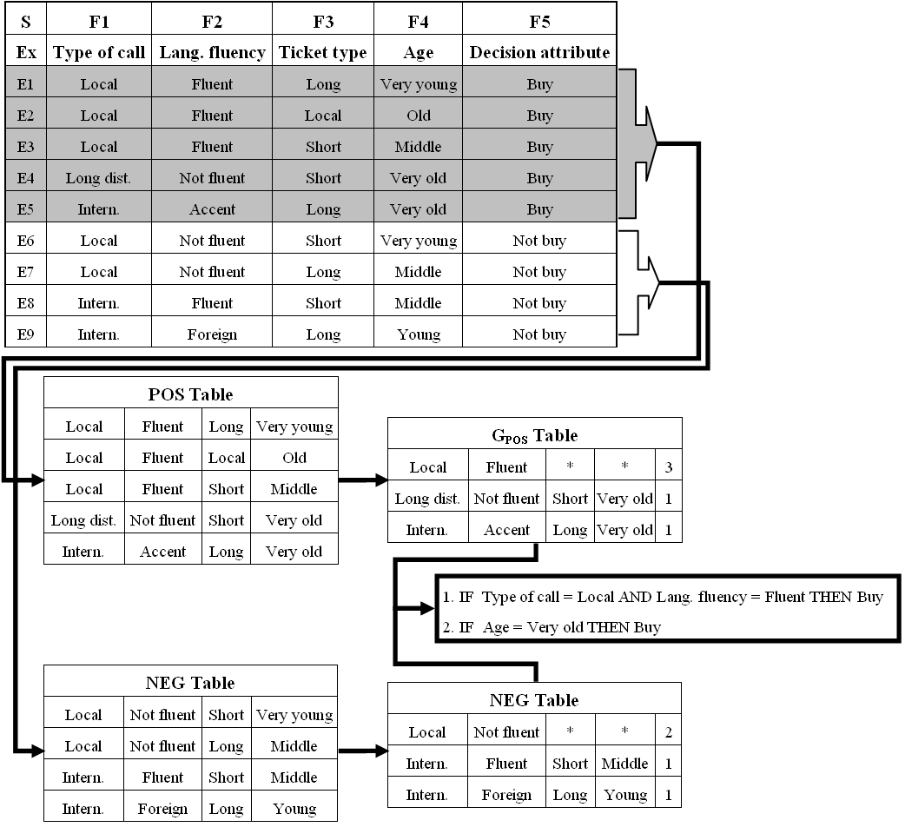
© 2007 Cios / Pedrycz / Swiniarski / Kurgan

Slide 9
DataSqueezer Algorithm
As result of the above operations the following two rules are generated, which cover all 5 POS training examples:
IF LangFluency = Fluent AND TypeofCall = Local THEN Buy (covers 3 examples)
IF Age = Very old THEN Buy
(covers 2 examples)
or as would the algorithm write it:
IF F2=1 AND F1=1 THEN F5=1 (covers 3 examples)
IF F4=5 THEN F5=1 (covers 2 examples)
© 2007 Cios / Pedrycz / Swiniarski / Kurgan

Slide 10
DataSqueezer Algorithm
Pruning Threshold is used to prune very specific rules. The rule generation process is terminated if the first selector added to rulei has saj value equal to or smaller than the threshold’s value. The algorithm induces rules by selecting selectors that cover the most of POS examples and removes examples that are already covered.
Generalization Threshold is used to allow for rules that cover a small number of negative data. It allows for accepting rules that cover negative examples; the number equal or smaller than this threshold.
© 2007 Cios / Pedrycz / Swiniarski / Kurgan

Slide 11
DataSqueezer Algorithm
DataSqueezer generates a set of rules for each class. Two outcomes are possible: a new example is assigned to a particular class, or it is left unclassified. To resolve possible conflicts:
all rules that cover a given example are found. If no rules cover it then it is left unclassified
for every class, the goodness of rules describing this class and covering the example is summed; the example is assigned to the class with the highest value. In case of a tie the example is left unclassified. The goodness value for each rule is equal to the percentage of the POS examples that it covers.
© 2007 Cios / Pedrycz / Swiniarski / Kurgan

Slide 12
DataSqueezer Algorithm
DataSqeezer treats all unclassified examples as incorrect classifications. As such, they contribute toward lowering the algorithm’s classification accuracy.
This is in contrast to C5.0 and other algorithms that use the default hypothesis, which states that
if an example is not covered by any rule it is assigned to the class with the highest frequency (the default class) in the training data.
This means that each example is always classified, however, this mechanism may lead to significant but artificial improvement in terms of accuracy of the model.
In the extreme case, for highly skewed datasets
(where one of the classes has significantly larger number of training examples)
it may lead to generation of the default hypothesis as the only rule.
© 2007 Cios / Pedrycz / Swiniarski / Kurgan

Slide 13
DataSqueezer Algorithm
# | abbr. | set | size | #class | #attrib. | test data | # | abbr. | set | size | #class | #attrib. | test data
1 | adult | Adult | 48842 | 2 | 14 | 16281 | 12 | led | LED display | 6000 | 10 | 7 | 4000
2 | bcw | Wisconsin breast cancer | 699 | 2 | 9 | 10CV | 13 | pid | PIMA indian diabetes | 768 | 2 | 8 | 10CV
3 | bld | BUPA liver disorder | 345 | 2 | 6 | 10CV | 14 | sat | StatLog satellite image | 6435 | 6 | 37 | 2000
4 | bos | Boston housing | 506 | 3 | 13 | 10CV | 15 | seg | image segmentation | 2310 | 7 | 19 | 10CV
5 | cid | census-income | 299285 | 2 | 40 | 99762 | 16 | smo | attitude smoking restr. | 2855 | 3 | 13 | 1000
6 | cmc | contraceptive method | 1473 | 3 | 9 | 10CV | 17 | spect | SPECT heart imaging | 267 | 2 | 22 | 187
7 | dna | StatLog DNA | 3190 | 3 | 61 | 1190 | 18 | tae | TA evaluation | 151 | 3 | 5 | 10CV
8 | forc | Forest cover | 581012 | 7 | 54 | 565892 | 19 | thy | thyroid disease | 7200 | 3 | 21 | 3428
9 | hea | StatLog heart disease | 270 | 2 | 13 | 10CV | 20 | veh | StatLog vehicle silhouette | 846 | 4 | 18 | 10CV
10 | ipum | IPUMS census | 233584 | 3 | 61 | 70076 | 21 | vot | congressional voting rec | 435 | 2 | 16 | 10CV
11 | kdd | Intrusion (kdd cup 99) | 805050 | 40 | 42 | 311029 | 22 | wav | waveform | 3600 | 3 | 21 | 3000
© 2007 Cios / Pedrycz / Swiniarski / Kurgan

Slide 14
Data set | C5.0 | CLIP4 | DataSqueezer
 |  |  | accuracy | sensitivity | specificity
bcw | 94 (±2.6) | 95 (±2.5) | 94 (±2.8) | 92 (±3.5) | 98 (±3.3)
bld | 68 (±7.2) | 63 (±5.4) | 68 (±7.1) | 86 (±18.5) | 44 (±21.5)
bos | 75 (±6.1) | 71 (±2.7) | 70 (±6.4) | 70 (±6.1) | 88 (±4.3)
cmc | 53 (±3.4) | 47 (±5.1) | 44 (±4.3) | 40 (±4.2) | 73 (±2.0)
dna | 94 | 91 | 92 | 92 | 97
hea | 78 (±7.6) | 72 (±10.2) | 79 (±6.0) | 89 (±8.3) | 66 (±13.5)
led | 74 | 71 | 68 | 68 | 97
pid | 75 (±5.0) | 71 (±4.5) | 76 (±5.6) | 83 (±8.5) | 61 (±10.3)
sat | 86 | 80 | 80 | 78 | 96
seg | 93 (±1.2) | 86 (±1.9) | 84 (±2.5) | 83 (±2.1) | 98 (±0.4)
smo | 68 | 68 | 68 | 33 | 67
tae | 52 (±12.5) | 60 (±11.8) | 55 (±7.3) | 53 (±8.4) | 79 (±3.8)
thy | 99 | 99 | 96 | 95 | 99
veh | 75 (±4.4) | 56 (±4.5) | 61 (±4.2) | 61 (±3.2) | 88 (±1.6)
vot | 96 (±3.9) | 94 (±2.2) | 95 (±2.8) | 93 (±3.3) | 96 (±5.2)
wav | 76 | 75 | 77 | 77 | 89
MEAN (stdev) | 78.5 (±14.4) | 74.9 (±15.0) | 75.4 (±14.9) | 74.6 (±19.1) | 83.5 (±16.7)
adult | 85 | 83 | 82 | 94 | 41
cid | 95 | 89 | 91 | 94 | 45
forc | 65 | 54 | 55 | 56 | 90
ipums | 100 | - | 84 | 82 | 97
kdd | 92 | - | 96 | 12 | 91
spect | 76 | 86 | 79 | 47 | 81
MEAN all (stdev) | 80.4 (±14.1) | 75.6 (±14.8) | 77.0 (±14.6) | 71.7 (±23.0) | 80.9 (±19.0)
© 2007 Cios / Pedrycz / Swiniarski / Kurgan

Slide 15
Data set | C5.0 |  |  | CLIP4 |  |  | DataSqueezer
 | mean # rules | mean # select | # select / rule | mean # rules | mean # select | # select / rule | mean # rules | mean # select | # select / rule
bcw | 16 | 16 | 1.0 | 4 | 122 | 30.5 | 4 | 13 | 3.3
bld | 14 | 42 | 3.0 | 10 | 272 | 27.2 | 3 | 14 | 4.7
bos | 18 | 68 | 3.8 | 10 | 133 | 13.3 | 20 | 107 | 5.4
cmc | 48 | 184 | 3.8 | 8 | 61 | 7.6 | 20 | 70 | 3.5
dna | 40 | 107 | 2.7 | 8 | 90 | 11.3 | 39 | 97 | 2.5
hea | 10 | 21 | 2.1 | 12 | 192 | 16.0 | 5 | 17 | 3.4
led | 20 | 79 | 4.0 | 41 | 189 | 4.6 | 51 | 194 | 3.8
pid | 10 | 22 | 2.2 | 4 | 64 | 16.0 | 2 | 8 | 4.0
sat | 96 | 498 | 5.2 | 61 | 3199 | 52.4 | 57 | 257 | 4.5
seg | 42 | 181 | 4.3 | 39 | 1170 | 30.0 | 57 | 219 | 3.8
smo | 0 | 0 | 0 | 18 | 242 | 13.4 | 6 | 12 | 2.0
tae | 12 | 33 | 2.8 | 9 | 273 | 30.3 | 21 | 57 | 2.7
thy | 7 | 15 | 2.1 | 4 | 119 | 29.8 | 7 | 28 | 4.0
veh | 37 | 142 | 3.8 | 21 | 381 | 18.1 | 24 | 80 | 3.3
vot | 4 | 6 | 1.5 | 10 | 52 | 5.2 | 1 | 2 | 2.0
wav | 30 | 119 | 4.0 | 9 | 85 | 9.4 | 22 | 65 | 3.0
MEAN Stdev | 25.3 (±23.9) | 95.8 (±123.5) | 2.9 (±1.4) | 16.8 (±16.3) | 415.3 (±789.1) | 18.9 (±12.7) | 21.2 (±19.8) | 77.5 (±80.3) | 3.4 (±0.9)
Adult | 54 | 181 | 3.3 | 72 | 7561 | 105.0 | 61 | 395 | 6.5
cid | 146 | 412 | 2.8 | 19 | 1895 | 99.7 | 15 | 95 | 6.3
forc | 432 | 1731 | 4.0 | 63 | 2438 | 38.7 | 59 | 2105 | 35.7
Ipums | 75 | 197 | 2.6 | - | - | - | 108 | 1492 | 13.8
kdd | 108 | 354 | 3.3 | - | - | - | 26 | 409 | 15.7
spect | 4 | 6 | 1.5 | 1 | 9 | 9.0 | 1 | 9 | 9.0
MEAN all stdev | 55.6 (±92.3) | 200.6 (±368.6) | 2.9 (±1.2) | 21.2 (±21.8) | 927.4 (±1800.6) | 28.4 (±28.2) | 27.7 (±27.6) | 261.1 (±520.2) | 6.5 (±7.4)
© 2007 Cios / Pedrycz / Swiniarski / Kurgan

Slide 16
Hybrid Algorithms
A hybrid algorithm combines methods from two or more types of algorithms
The goal of a hybrid algorithm design is to use the most useful mechanisms from other algorithms, and combine them to achieve better robustness, speed, accuracy, etc.
© 2007 Cios / Pedrycz / Swiniarski / Kurgan

Slide 17
Hybrid Algorithms
Hybrid algorithms that combine decision trees and rule algorithms:
CN2 algorithm (Clark and Niblett, 1989)
CLIP algorithms
CLILP2 (Cios and Liu, 1995)
CLIP3 (Cios, Wedding and Liu, 1997)
CLIP4 (Cios and Kurgan, 2004)
© 2007 Cios / Pedrycz / Swiniarski / Kurgan

Slide 18
CLIP4 Algorithm
An important characteristic distinguishing CLIP4 from a vast majority of ML algorithms is that it generates production rules that involve inequalities.
This results in generating small number of compact rules, especially in domains where attributes have large number of values, and where majority of them are correlated with the target class.
Another key characteristic of CLIP4 is its extensive use of the set covering (SC) problem and its novel solution that constitutes its core operation.
The SC is used to select the most discriminating features,
to grow new branches of the tree,
to select data subsets from which it generates the least overlapping rules, and
to generate final rules from the (virtual) tree leafs, which store subsets of the data.
© 2007 Cios / Pedrycz / Swiniarski / Kurgan

Slide 19
CLIP4’s Set Covering Algorithm
CLIP4’s set covering algorithm is a simplified version of integer programming (IP).
Several simplifications are made to the IP model to transform it into the SC problem:
a) the function that is subject of optimization has all coefficients set to one,
b) their variables are binary, x_{i}={0,1},
c) constraint function coefficients are also binary, and
d) all constraint functions are greater or equal to one.
The SC problem is NP-hard.
© 2007 Cios / Pedrycz / Swiniarski / Kurgan

Slide 20
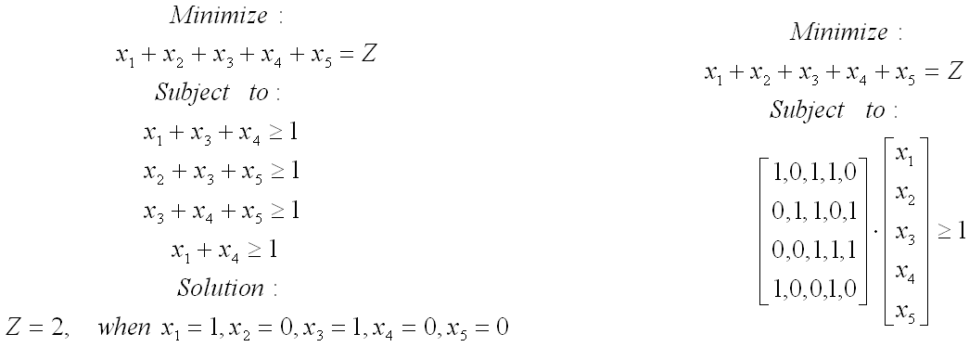
CLIP4’s Set Covering Algorithm
© 2007 Cios / Pedrycz / Swiniarski / Kurgan

Slide 21
CLIP4’s Set Covering Algorithm
Given: BINary matrix, Initialize: Remove all empty (non-active) rows from the BINary matrix; if the matrix has no 1’s then return error.
1. Select active rows that have the minimum number of 1’s in rows – min-rows
2. Select columns that have the maximum number of 1’s within the min-rows – max-columns
3. Within max-columns find columns that have the maximum number of 1’s in all active rows – max-max-columns, if there is more than one max-max-column go to 4., otherwise go to 5.
4. Within max-max-columns find the first column that has the lowest number of 1’s in the inactive rows
5. Add the selected column to the solution
6. Mark the inactive rows, if all the rows are inactive then terminate; otherwise go to 1.
where: the active row is the row that is not covered by the partial solution, and the inactive row is the row that is already covered by the partial solution.
© 2007 Cios / Pedrycz / Swiniarski / Kurgan

Slide 22
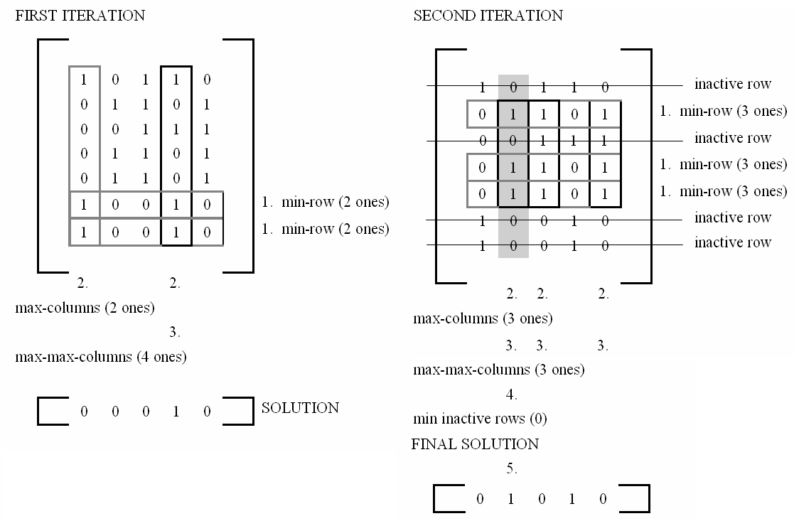
CLIP4’s Set Covering Algorithm
© 2007 Cios / Pedrycz / Swiniarski / Kurgan

Slide 23
CLIP4 Algorithm
The set of all training examples is denoted by S.
A subset of positive examples is denoted by SP and the subset of negative examples by SN.
SP and SN are represented by matrices whose rows represent examples and columns correspond to attributes.
Matrix of the positive examples is denoted as POS and their number by NPOS. Similarly for the negative examples we have matrices NEG and NNEG, respectively.
The following properties are satisfied for the subsets:
SP ∪ SN=S, SP ∩ SN=∅, SN ≠ ∅, and SP ≠ ∅
© 2007 Cios / Pedrycz / Swiniarski / Kurgan

Slide 24
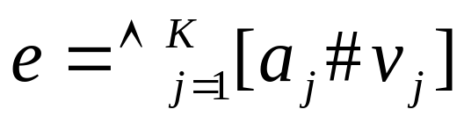
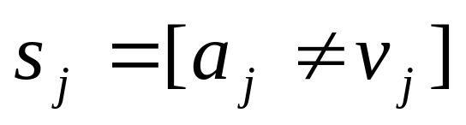
CLIP4 Algorithm
Examples are described by a set of K attribute-value pairs:
where a_{j} denotes j^{th} attribute with value v_{j} ∈ d_{j}, # is a
relation (≠, =, <, ≈, ≤, etc.), where K is the number of attributes.
An example e consists of set of selectors
The CLIP4 algorithm generates rules in the form:
IF (s₁∧…∧s_{m}) THEN class = class_{i}
where all selectors are only in the form s_{i} = [a_{j} ≠ v_{j}], namely,
use only inequalities.
© 2007 Cios / Pedrycz / Swiniarski / Kurgan

Slide 25
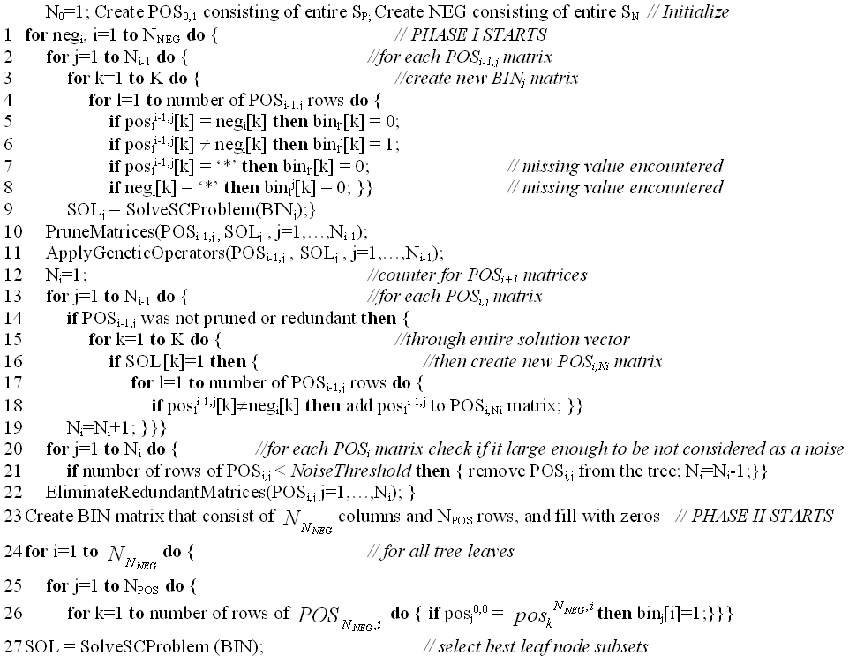
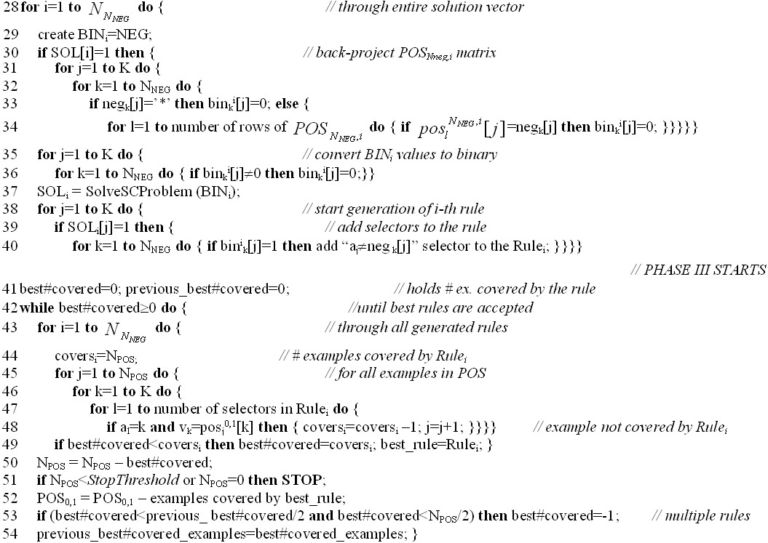
CLIP4 Algorithm
© 2007 Cios / Pedrycz / Swiniarski / Kurgan

Slide 26
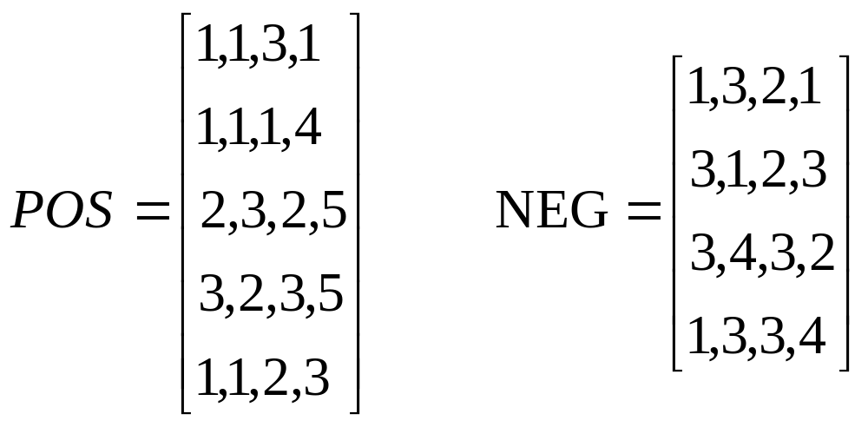
CLIP4 Algorithm
© 2007 Cios / Pedrycz / Swiniarski / Kurgan

Slide 27
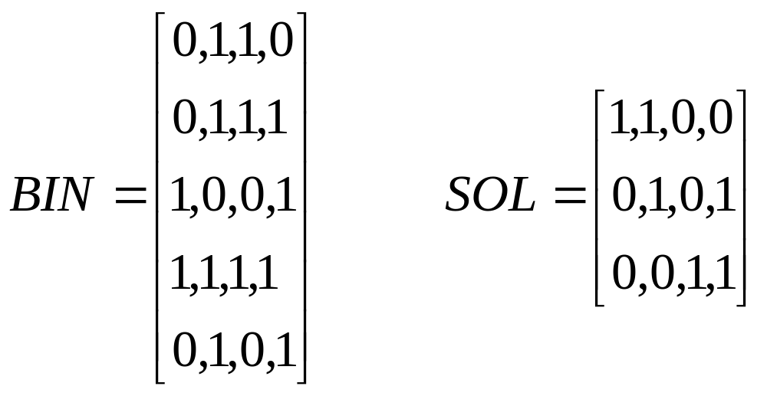
CLIP4 Algorithm
Phase 1: Using the first negative example [1,3,2,1] and matrix POS
we obtain the following binary matrix
© 2007 Cios / Pedrycz / Swiniarski / Kurgan

Slide 28
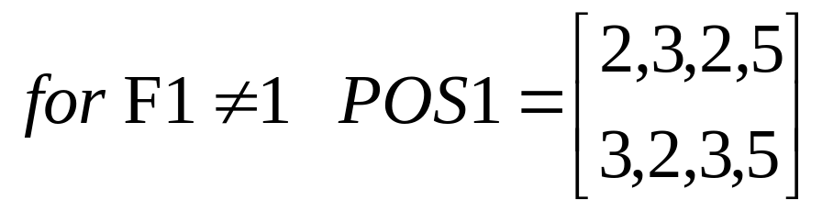
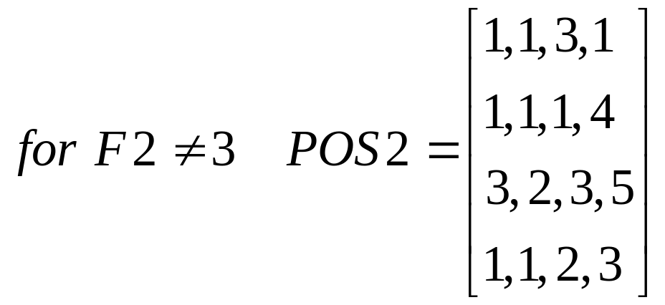
CLIP4 Algorithm
© 2007 Cios / Pedrycz / Swiniarski / Kurgan

Slide 29
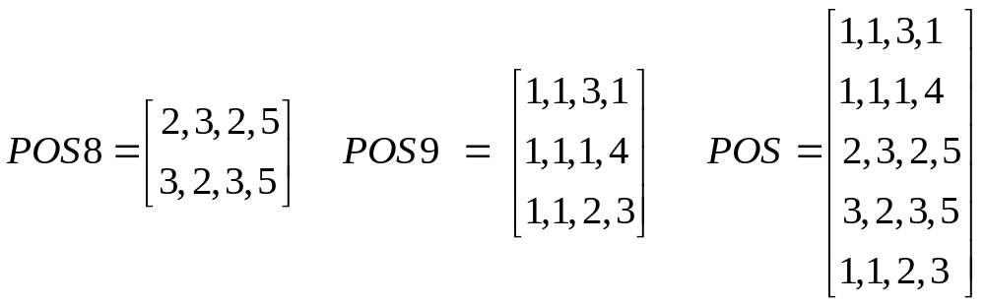
CLIP4 Algorithm
Phase 2: After repeating the process illustrated above, at the end of
Phase 1 we end up with just two matrices (the leaf nodes of the virtual
decision tree); the matrix numbers 8 and 9 are not important:
© 2007 Cios / Pedrycz / Swiniarski / Kurgan

Slide 30
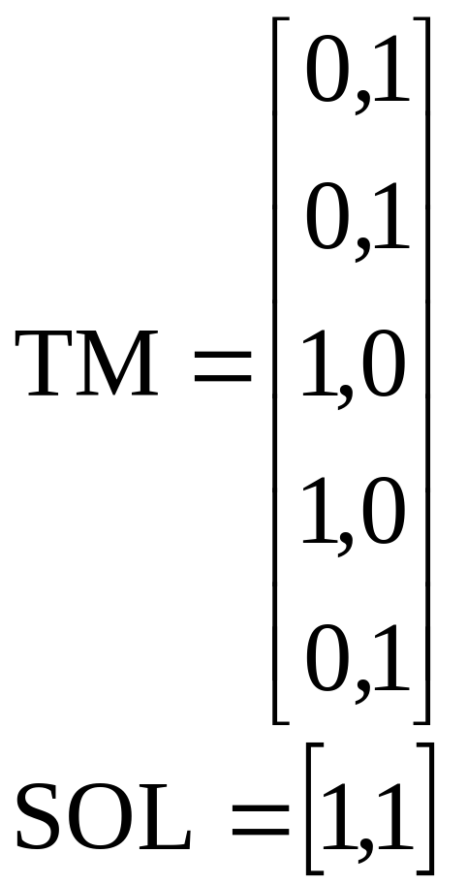
CLIP4 Algorithm
© 2007 Cios / Pedrycz / Swiniarski / Kurgan

Slide 31
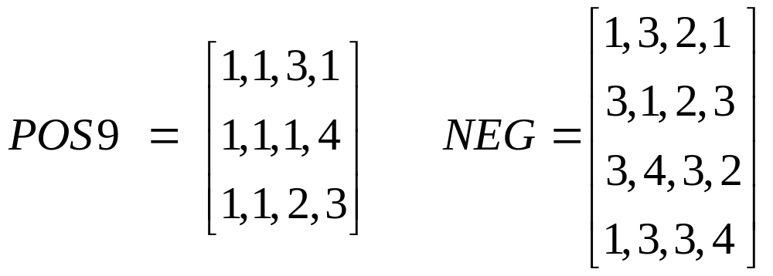
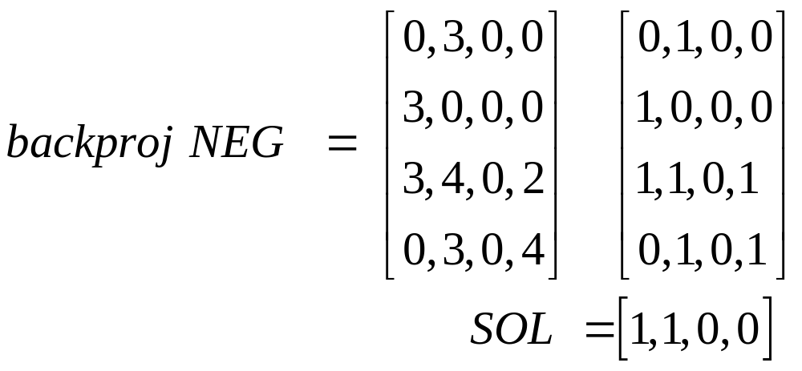
CLIP4 Algorithm
© 2007 Cios / Pedrycz / Swiniarski / Kurgan

Slide 32
CLIP4 Algorithm
From this solution and from the backproj NEG matrix we generate the first rule:
IF (F1≠3) AND (F2≠3) AND (F2≠4) THEN F5=Buy
(covers examples e1,e2 and e5)
By the same process, using POS8, we generate one more rule:
IF (F4≠1) AND (F4≠3) AND (F4≠2) AND (F4≠4)
THEN F5=Buy
(covers examples e3 and e4)
© 2007 Cios / Pedrycz / Swiniarski / Kurgan

Slide 33
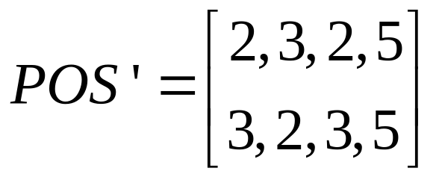
CLIP4 Algorithm
Phase 3: Using the CLIP4’s heuristic, however, we choose only the
first rule and remove from matrix POS all examples covered the first
rule. Next, we repeat the entire process on the reduced matrix POS:
After going again through all the phases of the algorithm we generate
just one rule:
IF (F4≠1) AND (F4≠3) AND (F4≠2) AND (F4≠4) THEN F5=Buy
© 2007 Cios / Pedrycz / Swiniarski / Kurgan

Slide 34
CLIP4 Algorithm
As the final outcome, in two iterations, the algorithm generated a set of rules that cover all positive examples and none of the negative:
IF (F1≠3) AND (F2≠3) AND (F2≠4) THEN F5=Buy
IF (F4=5) THEN F5=Buy
Notice that by knowing feature values for attribute F4 it is possible to convert the second rule into the equalities rule, as written above.
Verbally the two rules say:
IF Call ≠ International AND Language Fluency ≠ Bad AND Language Fluency ≠ Foreign THEN Buy
IF Customer is 80 years or older THEN Buy
© 2007 Cios / Pedrycz / Swiniarski / Kurgan

Slide 35
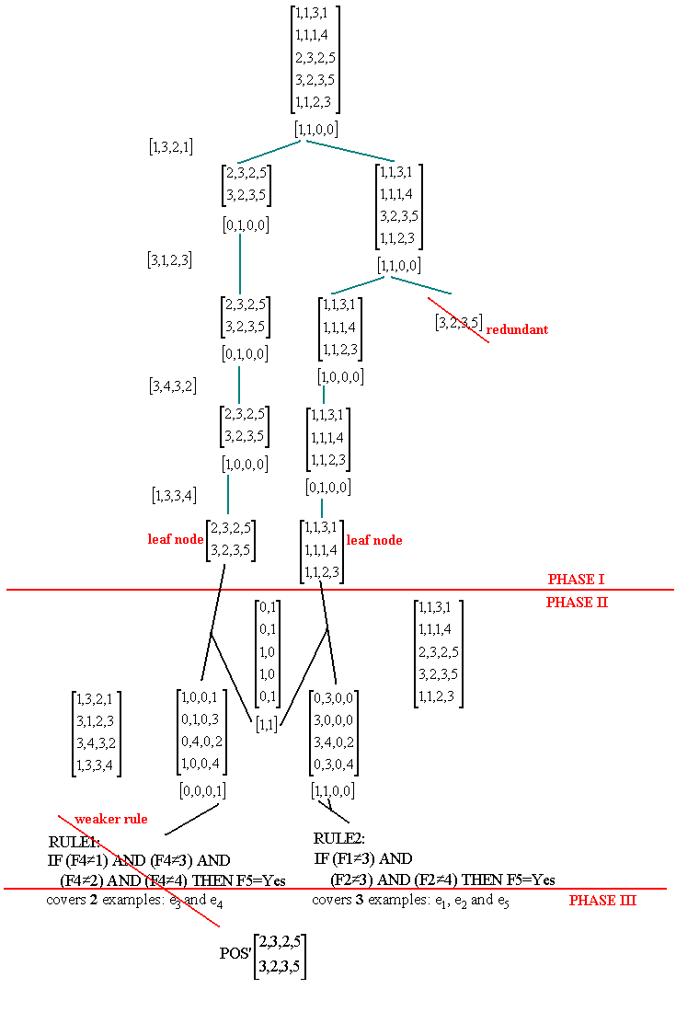
CLIP4 Algorithm
© 2007 Cios / Pedrycz / Swiniarski / Kurgan

Slide 36
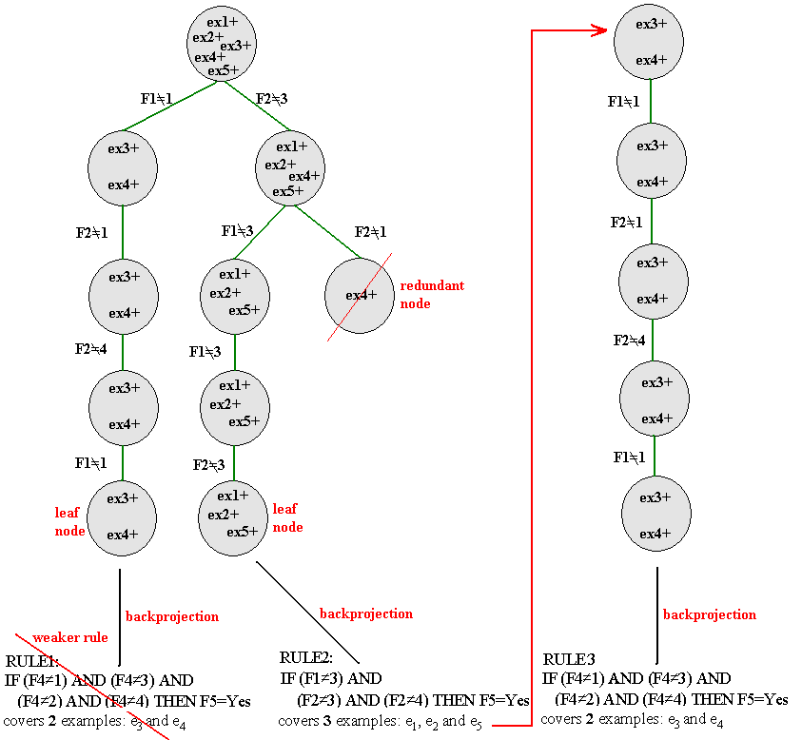
CLIP4
Algorithm
© 2007 Cios / Pedrycz / Swiniarski / Kurgan

Slide 37
Handling of Missing Values
ex. # | F1 | F2 | F3 | F4 | class
1 | 1 | 2 | 3 | * | 1
2 | 1 | 3 | 1 | 2 | 1
3 | * | 3 | 2 | 5 | 1
4 | 3 | 3 | 2 | 2 | 1
5 | 1 | 1 | 1 | 3 | 1
6 | 3 | 1 | 2 | 5 | 2
7 | 1 | 2 | 2 | 4 | 2
8 | 2 | 1 | * | 3 | 2
IF F1≠3 AND F1≠2 AND F3≠2 THEN class 1 (covers 1,2,5)
IF F2≠2 AND F2≠1 THEN class 1 (covers 2,3,4)
They cover all positive examples, including those with missing values
and none of the negative examples. Notice that both cover the second
example.
© 2007 Cios / Pedrycz / Swiniarski / Kurgan

Slide 38
Thresholds
Noise Threshold determines which nodes are pruned from the tree grown in Phase 1. The threshold prunes every node that contains less number of examples than its value.
Pruning Threshold is used to prune nodes from the generated tree. It uses a goodness value to perform selection of the nodes. The threshold selects the first few nodes with the highest value and removes the remaining nodes from the tree.
Stop Threshold stops the algorithm when smaller than the threshold number of positive examples remains uncovered.
CLIP4 generates rules by partitioning the data into subsets containing similar examples, and removes examples that are covered by the already generated rules.
The noise and stop thresholds are specified as percentage of the size of positive data and thus are easily scalable.
© 2007 Cios / Pedrycz / Swiniarski / Kurgan

Slide 39
Evolutionary Computing
Genetic Algorithmic Aspects
Fundamental Components
Genetic Computing
© 2007 Cios / Pedrycz / Swiniarski / Kurgan

Slide 40
Evolutionary Computing
Evolutionary computing is concerned with population-oriented, evolution-like optimization
It exploits the entire population of potential solutions and evolves according to genetics-driven principles
Genetic algorithms (GA) are search algorithms based on mechanisms of natural selection and genetics
© 2007 Cios / Pedrycz / Swiniarski / Kurgan

Slide 41
GA: Algorithmic Aspects
GA exploits the mechanism of natural selection (survival of the fittest) by:
  collecting an initial population of N elements
  determining suitability for survival of its individuals
  evolving the population to retain the individuals with the highest values of the fitness function
  eliminating the weakest individuals
Result: Individuals with the highest ability to survive
© 2007 Cios / Pedrycz / Swiniarski / Kurgan

Slide 42
GA: Algorithmic Aspects
GA uses the concept of recombination and mutation
of individual elements/chromosomes to:
generate new offspring, and
increase diversity, respectively.
© 2007 Cios / Pedrycz / Swiniarski / Kurgan

Slide 43
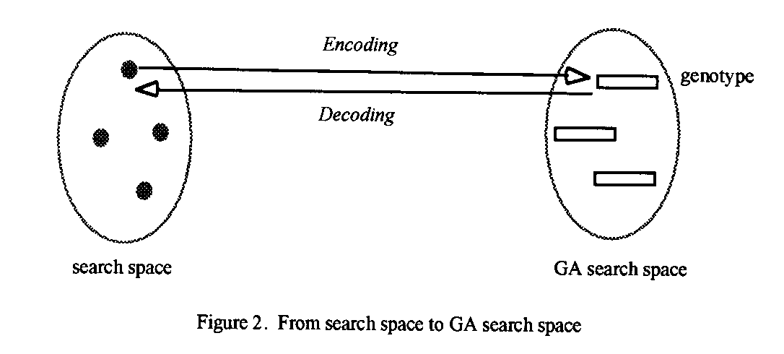
GA: Algorithmic Aspects
Genetic manipulation requires the original space to be transformed into a GA search space (encoding).
© 2007 Cios / Pedrycz / Swiniarski / Kurgan

Slide 44
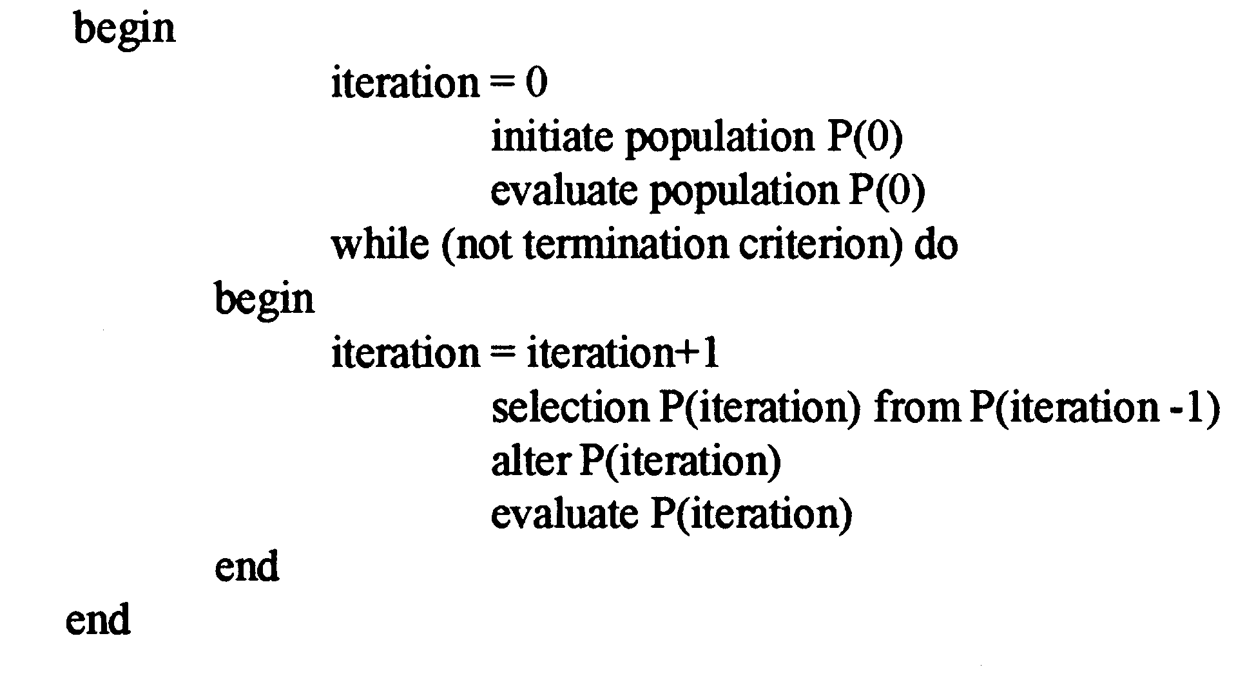
GA Pseudocode
© 2007 Cios / Pedrycz / Swiniarski / Kurgan

Slide 45
GA Pseudocode
GA algorithm pseudocode:
start with an initial population and evaluate each of its elements by a fitness function
elements with high fitness have high chance of survival,
while those with low fitness are gradually eliminated
© 2007 Cios / Pedrycz / Swiniarski / Kurgan

Slide 46
Fundamental Components of GAs
The main functional components of genetic computing are:
    encoding and decoding
    selection
    crossover
    mutation
© 2007 Cios / Pedrycz / Swiniarski / Kurgan

Slide 47
Fundamental Components of GAs
Encoding
Encoding transforms a real number into its binary equivalent. It transforms the original problem into a format suitable for genetic computations.
Decoding
Decoding transforms elements from the GA search space to the original search space
© 2007 Cios / Pedrycz / Swiniarski / Kurgan

Slide 48
Selection Mechanism
When a population of chromosomes in the search space is established,
we must define a way in which they are selected for further optimization phases.
Selection methods include:
  roulette wheel
  elitist strategies
© 2007 Cios / Pedrycz / Swiniarski / Kurgan

Slide 49
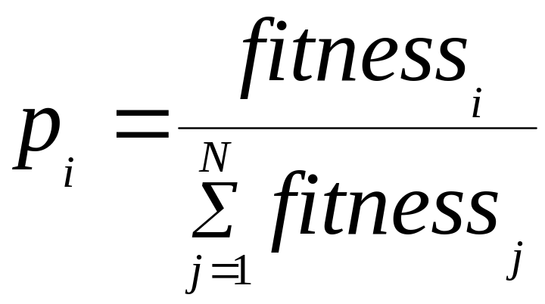
Roulette Wheel
Fitness values of the elements are normalized to 1
The normalized values are viewed as probabilities
The sum of fitness in the denominator characterizes a total fitness of population P.
© 2007 Cios / Pedrycz / Swiniarski / Kurgan

Slide 50
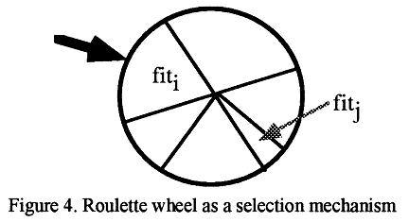
Roulette Wheel
Construct a roulette wheel with sectors reflecting probabilities of the strings and spin it N times.
© 2007 Cios / Pedrycz / Swiniarski / Kurgan

Slide 51
Elitist Strategy
Select the best individuals in the population and carry them over, without any alteration, to the next population of strings.
© 2007 Cios / Pedrycz / Swiniarski / Kurgan

Slide 52
Fundamental Components of GAs
Once the selection is completed, the resulting new population is subject to two GA mechanisms:
  crossover
  mutation
© 2007 Cios / Pedrycz / Swiniarski / Kurgan

Slide 53
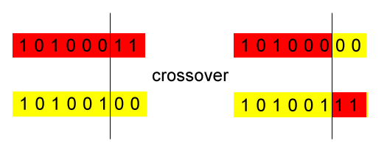
Crossover
A one-point crossover mechanism identifies two strings of a population and randomly selects a position in the strings at which they interchange their content, producing two new (offspring) strings.
© 2007 Cios / Pedrycz / Swiniarski / Kurgan

Slide 54
Crossover
Crossover leads to an increased diversity of the population of strings as new individuals emerge
The intensity of crossover is characterized in terms of the probability at which the elements of strings are affected. The higher the probability, the more individuals are affected by the crossover.
© 2007 Cios / Pedrycz / Swiniarski / Kurgan

Slide 55
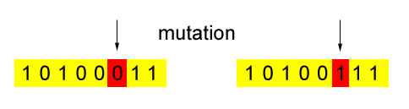
Mutation
Mutation adds additional diversity of a stochastic nature.
It is implemented by flipping the values of some randomly selected bits.
© 2007 Cios / Pedrycz / Swiniarski / Kurgan

Slide 56
Mutation
Mutation rate is related to the probability at which individual bits are affected.
  Example:
  5% mutation when applied to a population of 50 strings, each 20 bits long,
  means that 5% of the 1000 bits will be changed = 50 bits
© 2007 Cios / Pedrycz / Swiniarski / Kurgan

Slide 57
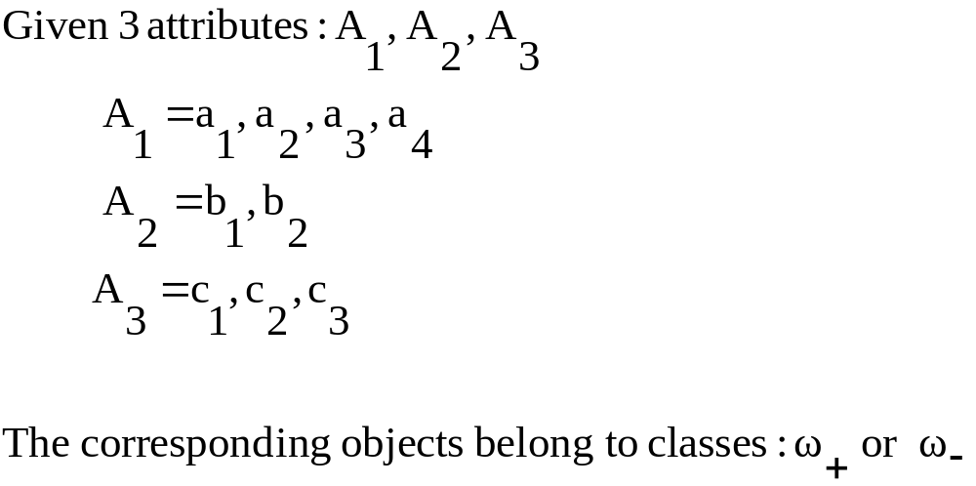
Rule Encoding Example
Task: construct rules that describe classes
© 2007 Cios / Pedrycz / Swiniarski / Kurgan

Slide 58
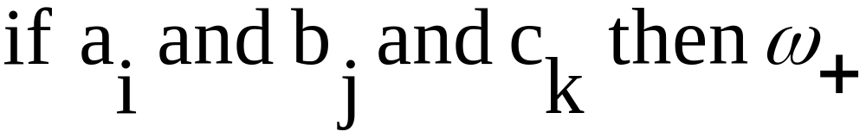
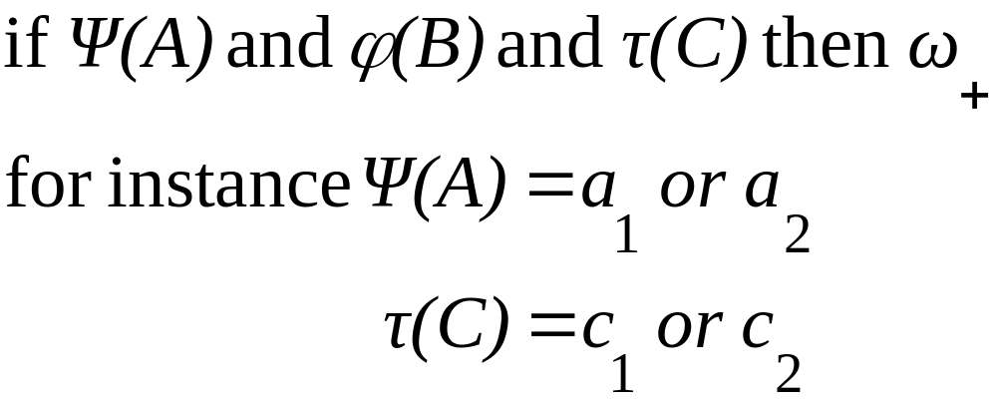
Rule Encoding Example
Structure of the rule:
where i=1,2,3,4 and j=1,2 and k=1,2,3
More generally:
© 2007 Cios / Pedrycz / Swiniarski / Kurgan

Slide 59
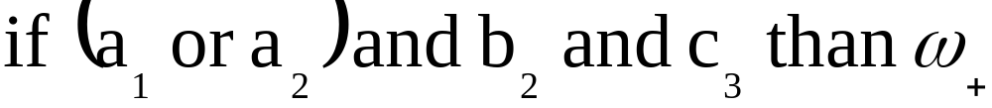
Rule Encoding Example
Assuming a single bit per value, encoding each attribute, we have:
    4 bit string: 1100
    2 bit string: 01
    3 bit string: 001
Therefore, each rule encodes as a string of 9 bits: 110001001
This string decodes as:
© 2007 Cios / Pedrycz / Swiniarski / Kurgan

Slide 60
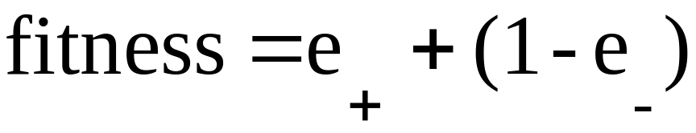
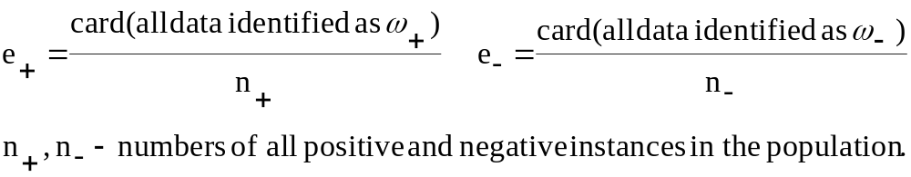
Rule Encoding Example
Fitness function describes how well the rule describes the data:
e₊ is a fraction of positive instances covered by the rule
e₋ is a fraction of the instances identified by the rule that do not belong to the class
© 2007 Cios / Pedrycz / Swiniarski / Kurgan

Slide 61
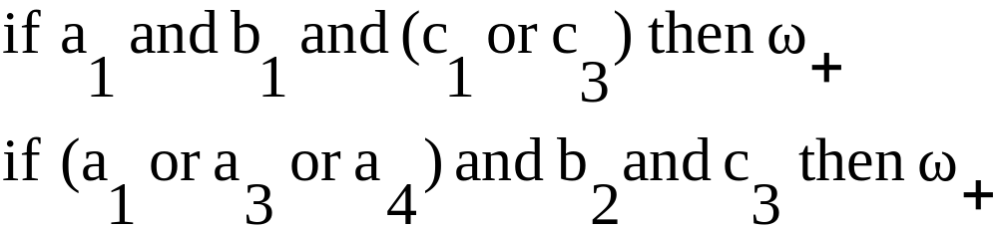
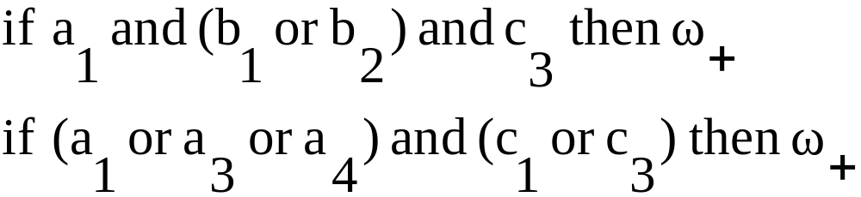
Crossover Mechanism Example
Applied to two strings:
100010101
101101001
Swapping after the fifth bit:
100011001
101100101
© 2007 Cios / Pedrycz / Swiniarski / Kurgan

Slide 62
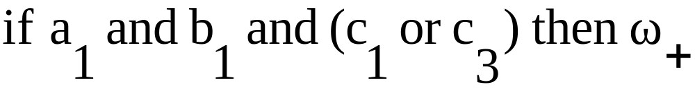
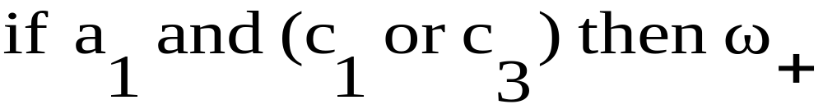
Mutation Mechanism Example
Applied to the string:
100010101
Changes the original rule into its mutated version:
100000101
© 2007 Cios / Pedrycz / Swiniarski / Kurgan

Slide 63
Use of GA Operators to Improve Accuracy
CLIP4 uses the GA in Phase I to enhance the partitioning of the data and obtain more “general” leaf node subsets. The components of the genetic module are:
population and individual
Individual/chromosome is defined as a node in the tree and consists of: POS_{i,j} matrix (jth matrix at the ith tree level) and SOL_{i,j} (the solution to the SC problem obtained from POS_{i,j} matrix)
Population is defined as a set of nodes at the same level of the tree.
encoding and decoding scheme
There is no need for encoding using the individuals defined above since GA operators are used on the binary SOL_{i,j} vector.
© 2007 Cios / Pedrycz / Swiniarski / Kurgan

Slide 64
Use of GA Operators to Improve Accuracy
selection of the new population
Initial population is the first tree level that consists of at least two nodes. CLIP4 uses the following fitness function to select the most suitable individuals for the next generation:
The fitness value is calculated as the number of rows of the POS_{i,j} matrix divided by the number of 1’s from the SOL_{i,j} vector. The fitness function has high values for the tree nodes that consist of large number of examples with low branching factor.
© 2007 Cios / Pedrycz / Swiniarski / Kurgan

Slide 65
Use of GA Operators to Improve Accuracy
The mechanism for selecting individuals for the next population is as follows:
all individuals are ranked using the fitness function
half of the individuals with the highest fitness are automatically selected for the next population (they will branch to create nodes for the next tree level)
the second half of the next population is generated by matching the best with the worst individuals (the best with the worst, the second best with the second worst, etc.) and applying GA operators to obtain new individuals (new nodes in the tree).
© 2007 Cios / Pedrycz / Swiniarski / Kurgan

Slide 66
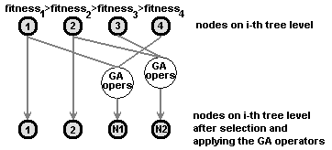
Use of GA Operators to Improve Accuracy
© 2007 Cios / Pedrycz / Swiniarski / Kurgan

Slide 67
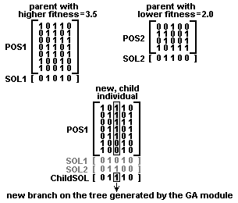
Use of GA Operators to Improve Accuracy
© 2007 Cios / Pedrycz / Swiniarski / Kurgan

Slide 68
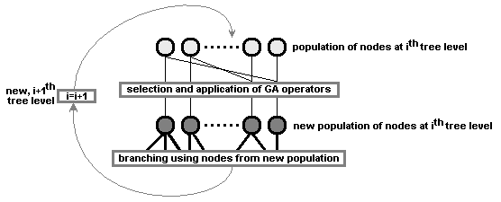
Use of GA Operators to Improve Accuracy
© 2007 Cios / Pedrycz / Swiniarski / Kurgan

Slide 69
Pruning
CLIP4 prunes the tree grown in Phase 1 as follows:
first, it selects a number (via the pruning threshold) of best nodes on the ith tree level. The selection is performed based on the goodness criterion. Only the selected nodes are used to branch into new nodes, and are passed to the (i+1)th tree level.
second, all redundant nodes that resulted from the branching process are removed. Two nodes are redundant if one mode contains positive examples that are identical, or form a subset of positive examples of the other node.
third, after the redundant nodes are removed, each new node is evaluated using the noise threshold. If it contains less examples than the one specified by the noise threshold then it is pruned.
© 2007 Cios / Pedrycz / Swiniarski / Kurgan

Slide 70
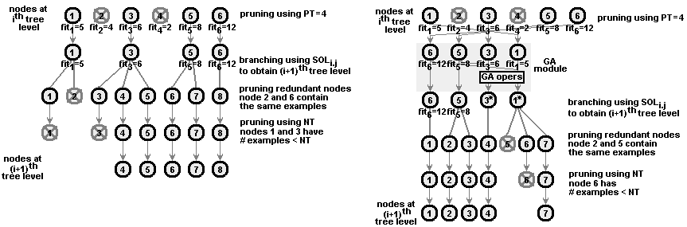
Pruning
© 2007 Cios / Pedrycz / Swiniarski / Kurgan

Slide 71
Feature and Selector Ranking
Goodness of each attribute and selector is computed using a set of generated rules. All attributes with goodness value greater than zero are strongly relevant, which means that the attribute cannot be removed without decreasing accuracy of classification. The attribute and selector goodness values are computed as follows:
Each generated rule has a goodness value equal to the percentage value of the training positive examples it covers.
Each selector has a goodness value equal to the goodness of the rule it comes from.
For each attribute, the sum of scaled goodness for all its selectors is computed and divided by the number of attribute values to obtain the goodness of the attribute.
© 2007 Cios / Pedrycz / Swiniarski / Kurgan

Slide 72
Feature and Selector Ranking
Suppose we have a two-category data, described by five attributes a1 through a5, that assume the following vales
a1 = {1, 2, 3}, a2 = {1, 2, 3}, a3 = {1, 2}, a4 = {1, 2, 3}, a5 = {1, 2, 3, 4}, while a6 = {1, 2} is the decision attribute.
Suppose CLIP4 generated the following rules from the data:
IF a5≠2 and a5≠3 and a5≠4 THEN class = 1
(covers 46% (29/62) positive examples)
IF a1≠1 and a1≠2 and a2≠2 and a2≠1 THEN class = 1
(covers 27% (17/62) positive examples)
IF a1≠1 and a1≠3 and a2≠3 and a2≠1 THEN class = 1
(covers 24% (15/62) positive examples)
IF a1≠2 a1≠3 and a2≠2 and a2≠3 THEN class = 1
(covers 14% (9/62) positive examples)
© 2007 Cios / Pedrycz / Swiniarski / Kurgan

Slide 73
Feature and Selector Ranking
After conversion, and using the information about attribute values we can obtain equality rules:
IF a5=1 THEN class = 1
(covers 46% (29/62) positive examples)
IF a1=3 and a2=3 THEN class = 1
(covers 27% (17/62) positive examples)
IF a1=2 and a2=2 THEN class = 1
(covers 24% (15/62) positive examples)
IF a1=1 and a2=1 THEN class = 1
(covers 14% (9/62) positive examples)
© 2007 Cios / Pedrycz / Swiniarski / Kurgan

Slide 74
Feature and Selector Ranking
We calculate goodness values for the selectors, shown below in descending order (after doing it we can calculate goodness of attributes):
(a5, 1); goodness 46
(a1, 3) and (a2, 3); goodness 27
(a1, 2) and (a2, 2); goodness 24
(a1, 1) and (a2, 1); goodness 14
In order to show their relative goodness they are scaled to the 0-100 range:
(a5, 1); goodness 100
(a1, 3) and (a2, 3); goodness 58.7
(a1, 2) and (a2, 2); goodness 52.2
(a1, 1) and (a2, 1); goodness 30.4
© 2007 Cios / Pedrycz / Swiniarski / Kurgan

Slide 75
Feature and Selector Ranking
Thus, for attribute a1 we have the following selectors and their goodness values:
(a1,3) with goodness 58.7, (a1,2) with goodness 52.2, and (a1,1) with goodness 30.4. From this we calculate goodness of the first attribute a1 as follows:
(58.7+52.2+30.4)/3 = 47.1
Similarly we calculate goodness of a2. For attribute a5, however, we have the following selectors and their goodness values: (a5,1) with goodness 100, (a5,2) until 4 with goodness of 0, thus its goodness is calculated as:
(100+0+0+0)/4 = 25.0
The remaining attributes, namely a3, a4 and a6 have all goodness value of 0 because they were not used in the generated rules.
© 2007 Cios / Pedrycz / Swiniarski / Kurgan

Slide 76
Feature and Selector Ranking
The feature and selector ranking performed by CLIP4 algorithm can be used to:
Select only relevant attributes (features) and discard irrelevant ones. The user can discard all attributes that have goodness of 0 and still have correct (with the same accuracy) model of the data.
Provide additional insight into data properties. The selector ranking can help in analyzing the data in terms of relevance of the selectors to the classification task.
© 2007 Cios / Pedrycz / Swiniarski / Kurgan

Slide 77
References
Cios K.J. and Liu N. 1992. Machine learning in generation of a neural network architecture: a Continuous ID3 approach. IEEE Trans. on Neural Networks, 3(2):280‑291
Cios, K.J., Pedrycz, W. and Swiniarski, R. 1998. Data Mining Methods for Knowledge Discovery. Kluwer
Cios, K.J. and Kurgan, L. 2004. CLIP4: Hybrid Inductive Machine Learning Algorithm that Generates Inequality Rules. Information Sciences, 163 (1-3): 37-83
Kurgan L., Cios K.J. and Dick S. 2006. Highly Scalable and Robust Rule Learner: Performance Evaluation and Comparison, IEEE Trans. on Systems Man and Cybernetics, Part B, 36(1):32-53
Kurgan, L. and Cios, K.J. 2002. CAIM Discretization Algorithm, IEEE Trans. on Knowledge and Data Engineering, 16(2): 145-153
© 2007 Cios / Pedrycz / Swiniarski / Kurgan

